Slide 2
About the Company
Facility Overview
Production Capability

Slide 3
History
First export to Singapore and Malaysia using TSP Brand
Laju Sinergi Metalindo
Established in 2018
Leading ductile iron producers
TSP Brand Launch
PT. LAJU SINERGI METALINDO is a subsidiary of PT. TRI SINAR PURNAMA as an additional product line with a more advanced technology. The company was established based on Notarial deed No. 35, Notary M. Dwi Hartati, SH in Semarang City on September 30, 2014. The deed has been approved by the Minister of Justice of the Republic of Indonesia Number AHU-40273.40.10.2014.
1994
2005
1983
1990
Today
G Brand launch
Launch OEM (Original Equipment Manufacturer) Products for P-Brand (Germany) and NKT Brand (Japan)
TSP has now successfully export to 20+ countries
TSP’s first project was the reconstruction of areas around Mt. Galunggung after it erupted. This event inspires the name of G Brand or Galunggung Brand
However in 2005, TSP decided to stick with their own brands TSP and G Brand and discontinued OEM
Established in 2017
Leading steel pipe nipple producers

Slide 4
About the Company
The Factory
We are striving in metal casting industry specializing in cast iron and ductile iron production. Our target market is infrastructure-related industry (building construction, transportation and electricity networks) and other industries that require products with the materials we produce
Building Size
Lt. 1 6,401 m2 + Lt. 2 425 m2 = 6,826 m2
Board of Directors
Land Area
Hidajat Purnama
Commissioner
Irene Tjahjadi
Commissioner
23,565 m2
Location
Jl. Tugu Wijaya IV No. Kawasan Industri 24, Wijaya Kusuma, Randugarut Tugu, Semarang, Indonesia 50153.
Levi Purnama
Director
Handy Purnama
Director

Slide 5
Facility Overview
PT. Laju Sinergi Metalindo research and development facility, supported by complete equipment and experienced domestic spare parts experts, is able to compete with foreign product standards
Primary Machines
Complete Vertical Production Line
Electric Induction Furnace
Shell Core Molding Machine
Shot Blasting Machine
Horizontal Molding Machine
Shotblast Hanger
Supporting Machines and Equipment
Spectrometer
Hoist Crane
Metallographic Microscope
Tensile Test Machine
Leak Testing Machine
Tapping Machine
Grinding Machine
Sieve Sifter
Teapot Laddle
Milling Machine
Permeability Tester
Sand Rammer
Universal Strength Tester
Active Clay Tester
Drill Machines
Tapping Machine
Hardness Tester

Slide 6
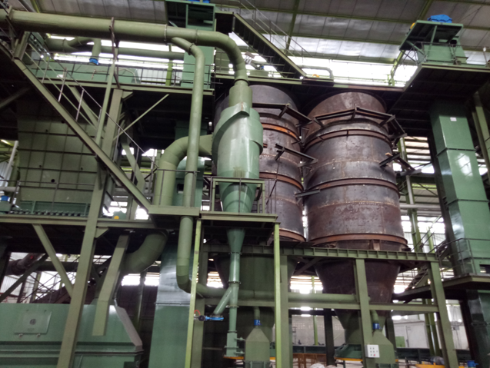
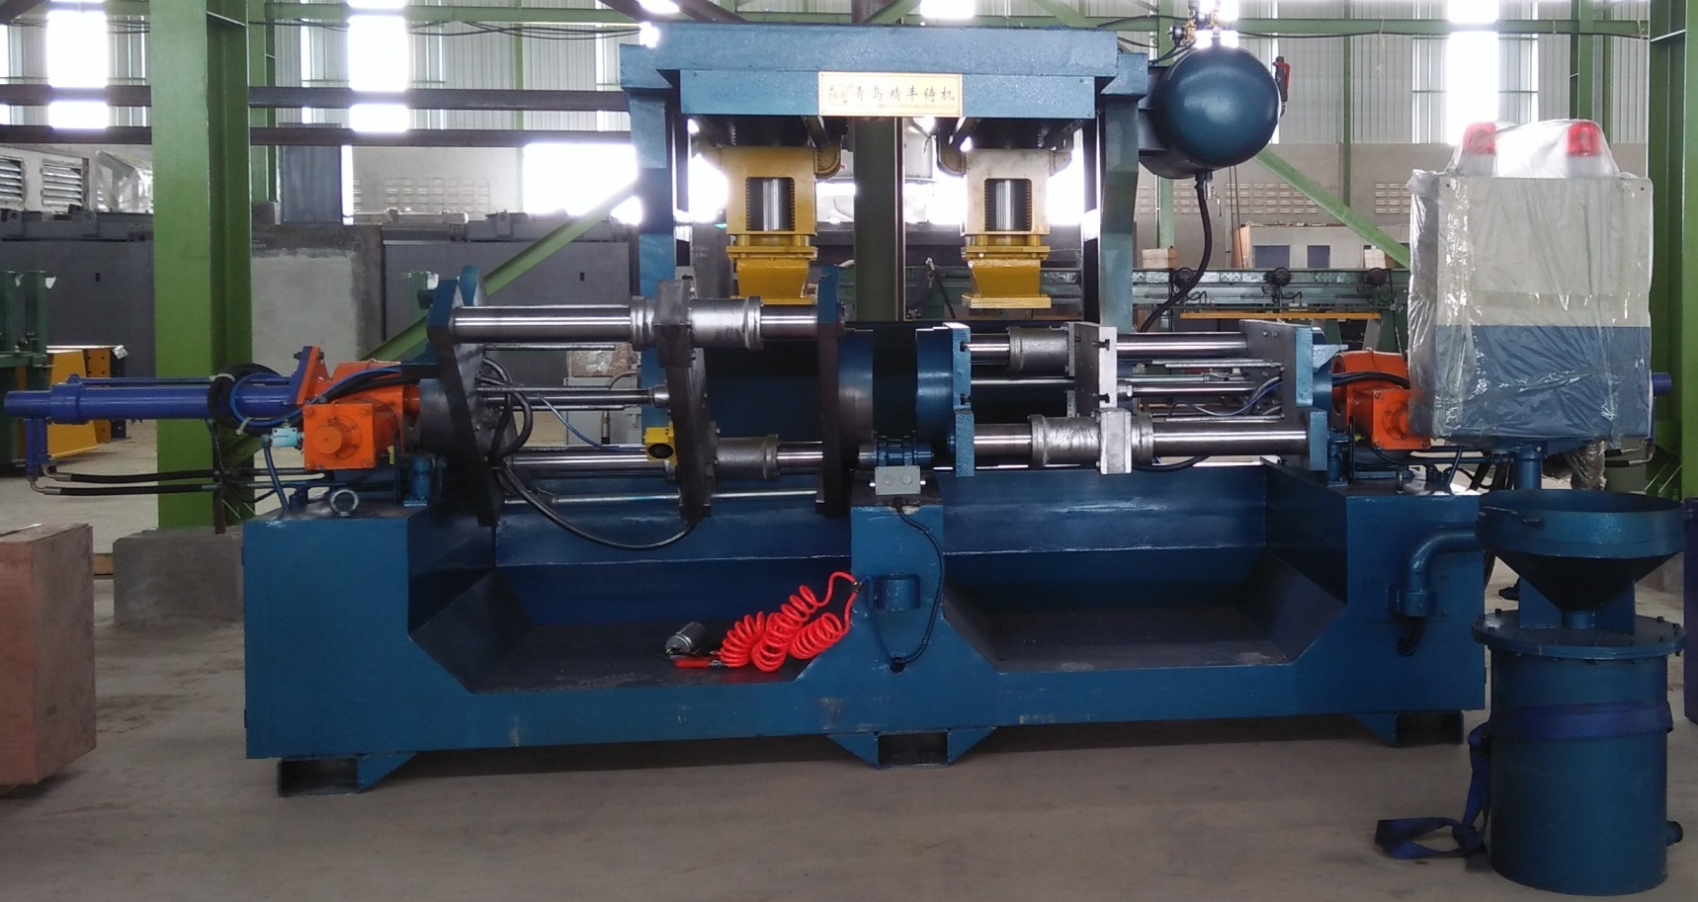
Primary Machines
Complete Vertical Production Line
Type XZZ416B
Frame size: 650mm x 535mm x (130mm -330mm)
Productivity: 350 mold/hour without core
One mold can hold a maximum of 25 kg liquid minimum 10 kg liquid
Induction Melting Furnace
Productivity rate: 3 tons of metal liquid / hour
Dual track system, medium frequency
Materials: cast iron (Ferro casting) and ductile iron (Ferro casting ductile)
Total power: 2200 kW

Slide 7
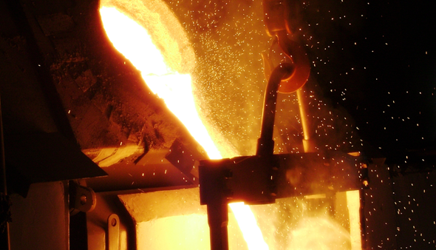
Primary Machines (continued)
Shell Core Molding Machine
Type Z956JS: 6 Units
Each unit consist of 2 core boxes
Maximum size of 400mm x 300mm x 250mm
Productivity rate of each machines: 90 seconds/mold
Shot Blasting Machine
Type QR3210A: 2 machine units
Type TD3210 Steel Apron 1 unit
Barrel end cover diameter: φ1000 mm
Barrel end cover rotation speed: 3.5 rpm
Maximum load: 600 kg & 800 kg
Productivity: 2000~2500kg/jam
Total power: 28.4kW

Slide 8
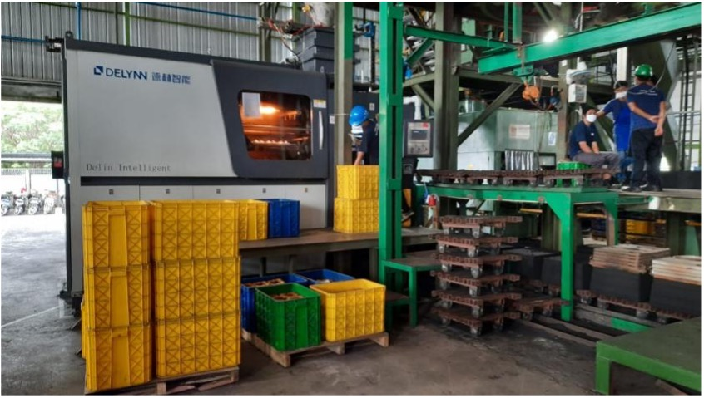
Primary Machines (continued)
Horizontal Molding Machine
Type DLZC5060H0
Frame size: 500 mm x 600mm x 280 mm
Productivity: 90 mold/hour without core
Hydraulic pressure : 15 Mpa
Power and Voltage : 16 Kw, 380 V, 50 Hz
Machine weight : 10 ton
Pattern plate thickness : 20 - 25 mm
One mold can hold a maximum of 25kg and minimum10kg liqui

Slide 9
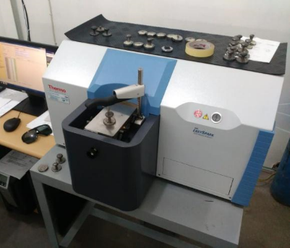
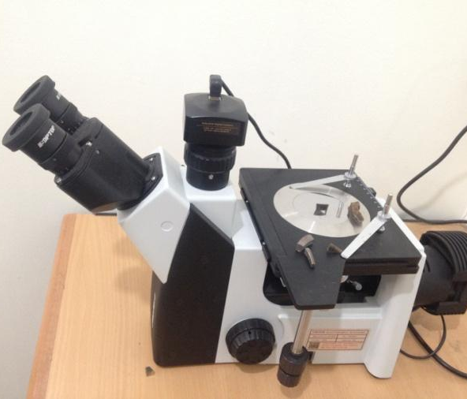
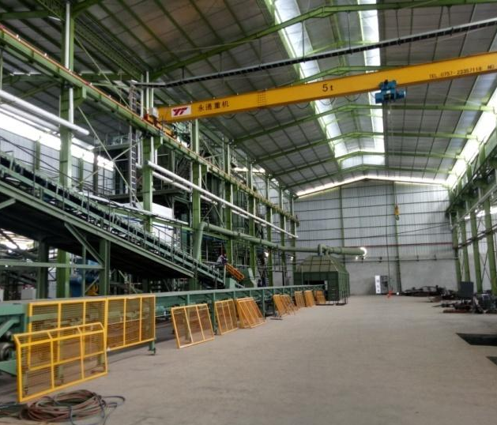
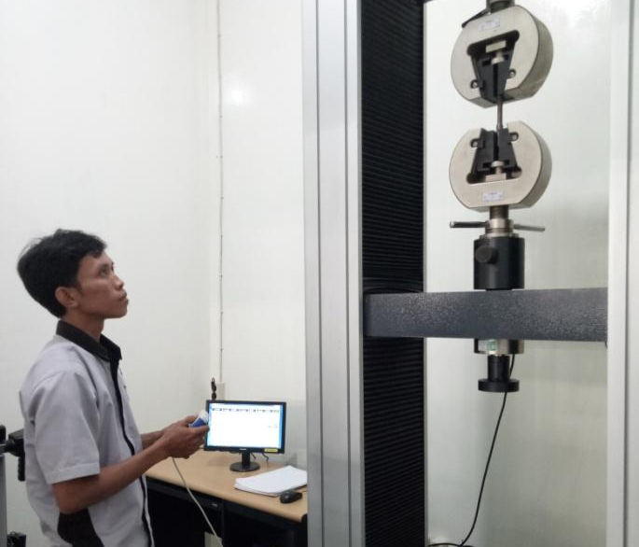
Supporting Machine and Equipment
Spectometer
Metallographic Microscope
Model: ARL Easypark AA83780-00
Made by Thermo Scientific
Eyepiece: PL10X/18mm plan
Objective: 195mm. LWD Professional Plan Metallurgical Objective (5X, 10X, 20X, 50X, 100X)
Focus: Fine and coarse coaxial, moving range 33mm, fine precision 0.001mm
Hoist Crane
Tensile Test Machine
5 ton single girder overhead crane
Capacity : 5ton
Span : 18m
Lifting height : 8.7m
Hoist speed :8m/min
Cross travel speed: 20m/min
Long travel speed: 30 m/min
Power supply: 380V 3P 50HZ
Control mode: remote control
Model : KJ-MJDW-200B
Power : 2K W
Voltage : 220 V

Slide 10
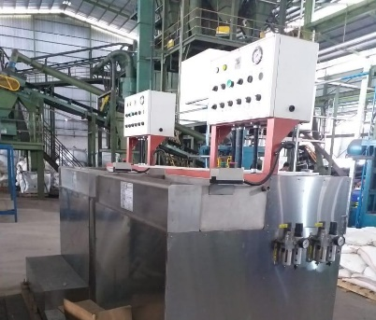
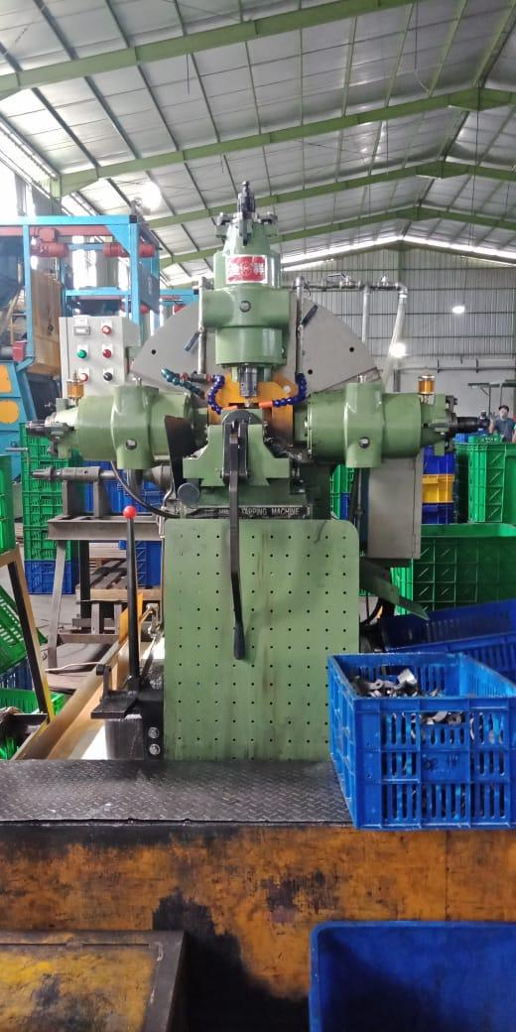
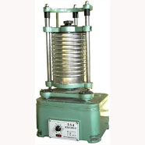
Supporting Machine and Equipment (Continued)
Leak Testing Machine
Grinding Machine
Model LT-70 : 3 Units
Range of testing : 1/2” – 2”
Air Consumption : 6.5L / Each Stroke
Qty of Each Testing : 6 pcs
Total 6 unit
Three Phase Motor Y 132S-4/ 7,5HP/1440 RPM
Power : 5.5K W
Voltage : 380 V
Tapping Machine
Sieve Sifter
Model : CHYUAN - HSIANG 5HP 1/8"- 2" ( 5 units)
Model : HEBEI OINGXIAN 11KW KAPASITAS 1" (1 unit)
Model : CHYUAN - HSIANG 1/8" - 1" (1 unit)
Model : LANG FANG 1/2" - 3/4" (1 unit)
Model : CHYUAN - HSIANG KT-1 A (1/8"-2") (1 unit)
Oscillating Times 230/min
Vibratory Hit Times 175/min
Amplitude of Vibration 2 to 3 mm

Slide 11
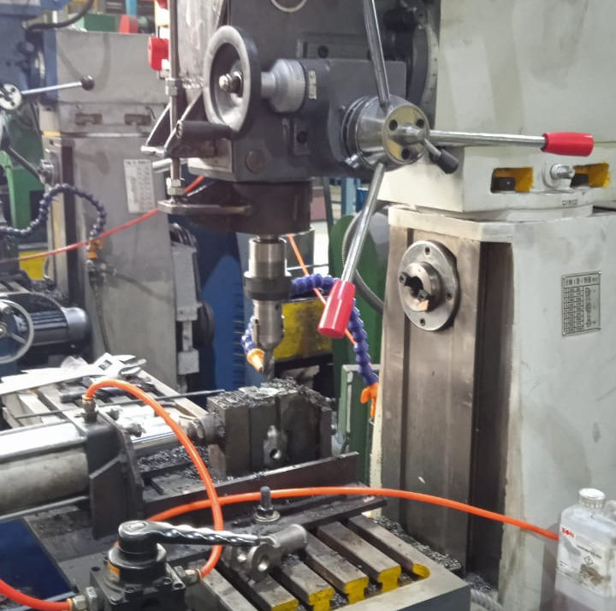
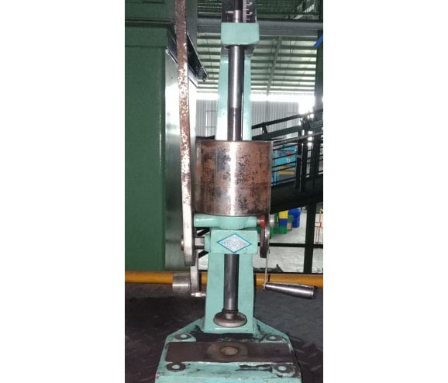
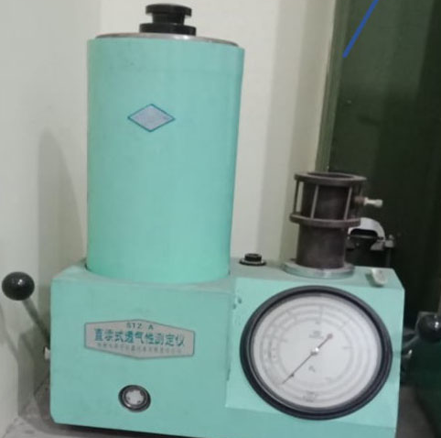
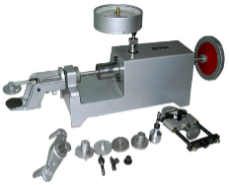
Supporting Machine and Equipment (Continued)
Milling Machine
Sand Rammer
Model 7550 & ZX7550CW straight drilling 50mm : 2 units
Three Phase motor 1,52KW
Voltage : 380 V; 4.3/5.4 A; 50 Hz
Horizontal wheel round velocity : 940/1440 R/MIN.
Model SSD-A
Weight of the heavy hammer: 6670 ± 10g
Falling height of the heavy hammer: 50 ± 0.5mm
Impacting of the heavy hammer: three
Profile dimension: 205x240x580mm.
Permeability Tester
Universal Strength Tester
Model STZ.A
Sample standard (diameter x height) 50 mmx50 mm
Bell volume : 2000ml
Pressure by air :100 mm water column
Size: 425 x 225 x 495 mm
Type SWY; Max pushing force by piston: 2400N
Stroke of handwheel :50 mm
Gauging Range of low pressure gauge
Gauging Range of high pressure gauge
Size: 600x180x330 mm

Slide 12
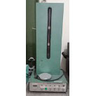
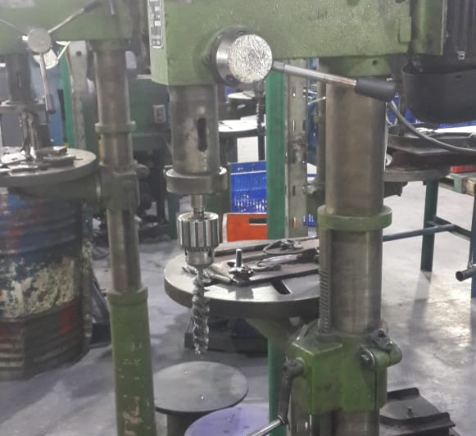
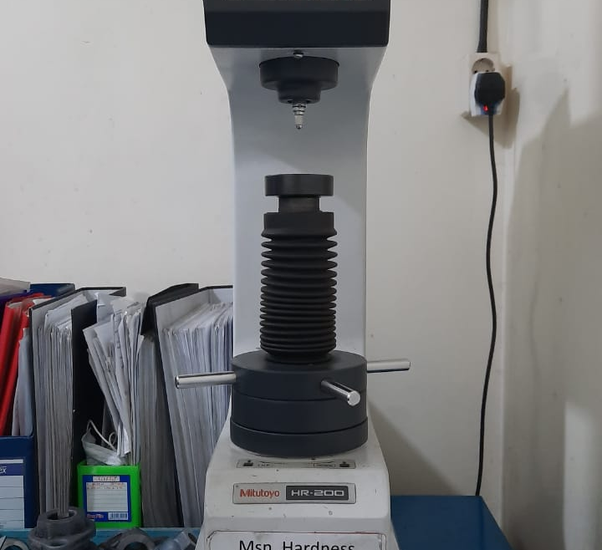
Supporting Machine and Equipment (Continued)
Active Clay Tester
Tapping Machine
Model : CHYUAN - HSIANG 5HP 1/8"- 2" ( 5 units)
Model : HEBEI OINGXIAN 11KW KAPASITAS 1" (1 unit)
Model : CHYUAN - HSIANG 1/8" - 1" (1 unit)
Model : LANG FANG 1/2" - 3/4" (1 unit)
Model : CHYUAN - HSIANG KT-1 A (1/8"-2") (1 unit)
Electric resource : 220±10% 50 Hz
Buret: 50ml±1%
Rotary speed of magnetic blender: 1400rpm
Size of the whole machine: 360x280x800mm
Drill Machines
Hardness Tester
Model: ZQD4132 31.5mm ( 5 units) and ZQD4125 25mm (1 unit)
Voltage: both 380V
Power: 0.37 KW and 1.1 KW
Model KR-17E Standard
Purpose : Soft Rubber or sand
Applied Standard : JIS 6253
Test Load : 550-8, 050 mN ( 56.1-821.1gf)
Model MITUTOYO/HR-210MR/ 1031903
Purpose : Ferrous
Test Load : 100 HRC & 100 HRB

Slide 13
World Class Electric Power Settings
Installed Electric Power
We use 5,540 KVA Premium Silver, which is a special cable directly from PLN to PT.Laju Sinergi Metalindo without any division with other networks greatly minimizing the risk of power outage
2.600 KVA for Induction Furnace power
1000 KVA for line molding, sand plant, utility and office
The rest of the power is reserved for backup

Slide 14
Management System and QC System
Management System
We are ISO 9001:2015 certified and we have developed SOP, QCPC and standard documentation for production process which will be
reviewed and completed continuously.
We developed new Engineering Department for development of new products with the head of engineering as the team supervisor.
QC System
QC process: incoming material, laboratorium for hardness, tensile, elongation, material composition, microstructure, visual checking, sand process, corebox, dimension, machining (threads, angle, leakage, chamfering, go no go), shipment.

Slide 15
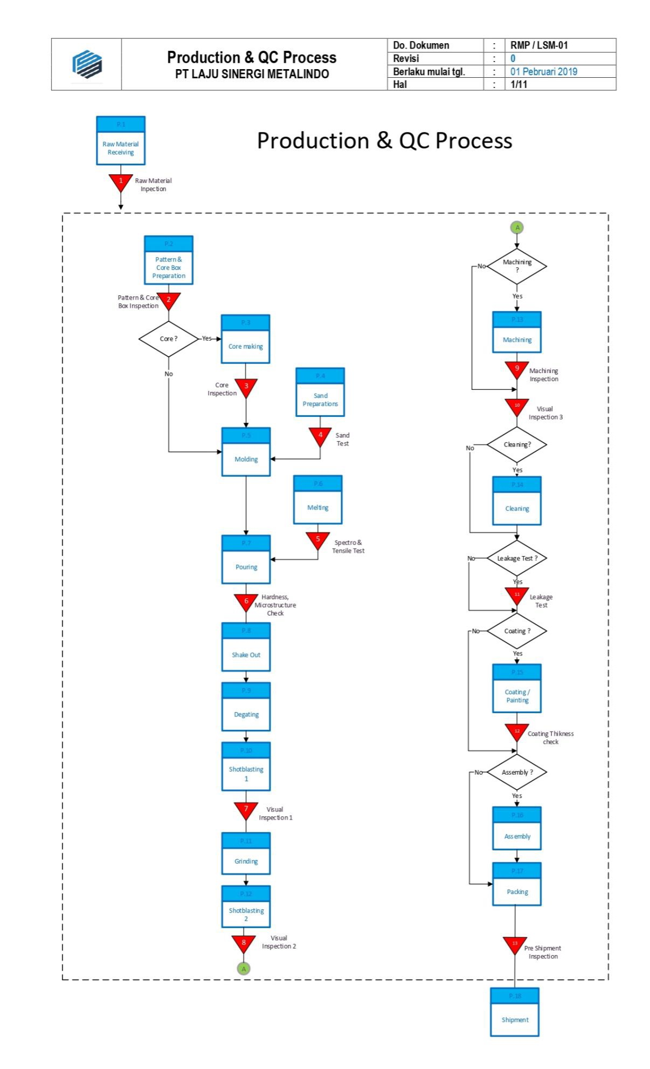
Production and QC Process

Slide 16
CONTACT US
info@lsm.id
+62-24-84310888
+62-811-2612000
www.lajusinergimetalindo.com
Jl. Tugu Wijaya Kusuma IV/24 Kelurahan Tugu,
Kecamatan Randugarut, Semarang 50153, Indonesia

